Slide 1

OrganiseMe: A Single-Page Productivity App
2026/03/25
Reporter: P Pek

Slide 2
Single-Page Web application Design

Slide 3



Task Management
Adding
Progress
Removing
Add Multible Tasks
Updeate thier Progess
Delete Them

Slide 4
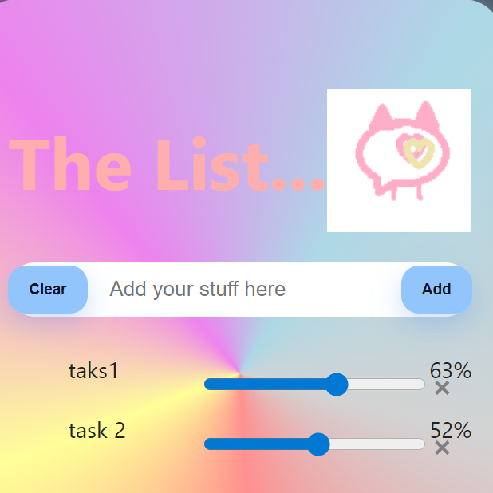
Progress Tracking
Auto Updates Each Time Upon Opening Site
Saves Each Time Upon Refresh
Progress

Slide 5
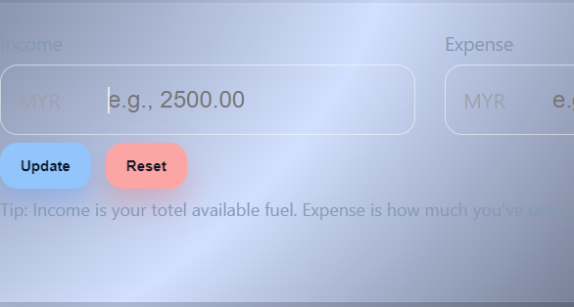
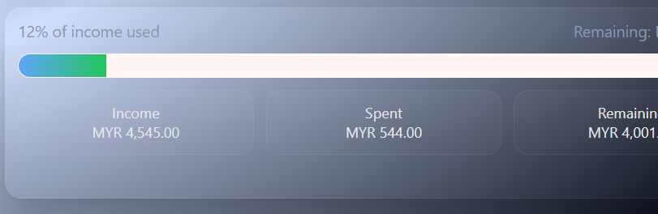
Budget Tracking
Income and expense input
01
02
Remaining balance calculation

Slide 6
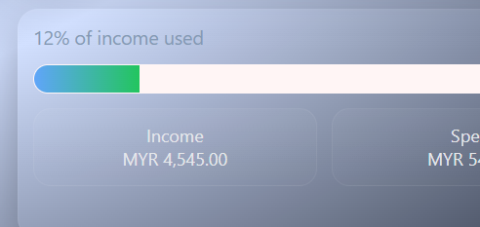
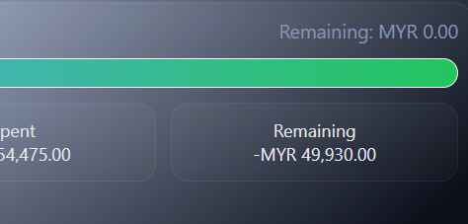
Visual Data Feedback
Progress bars for task completion and budget usage
Notifies You of Outstanding Balance

Slide 7
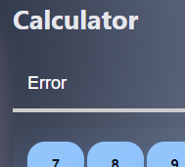
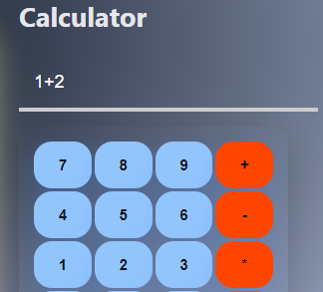
Calculator Utility
Good Error Handling
Basic Arithmatic Operations

Slide 8
Front-End Development
01
HTML for Structure
Web
Development
CSS for Layout and Design
02
Javascript for Interactivity
03

Slide 9




Software Development Lifecycle
Planning
Testing
Features Planned
Tests Done
Implementation
Reflection
Ways of Achive it
Overall...

Slide 10
User Interface and Usability
01
02
03
Clean Layout
Clear Sections
Easy Interaction
Clear and consise
Simple Buttons
Looks simple

Slide 11
Thank you
OrganiseMe

